Slide 1
Session 9
Graph Algorithms:
Topological Order
Minimum Spanning Trees (Prim)
Shortest Path (Dijkstra)

Slide 2
ILO: (Intended Learning Outcome)
To be able to explain the following algorithms (what is the algorithm used for? And how does it work?):
Topological order
Minimum spanning trees (Prim and/or Kruskal)
Dijkstra’s shortest path algorithm.
Have a running implementation of a graph:
Can explain, use and modify this implementation
Have started implemented a graph algorithm

Slide 3
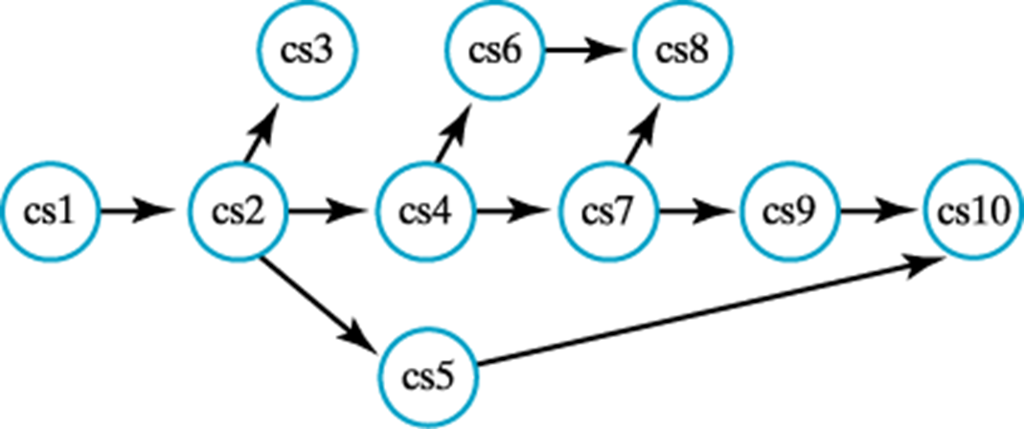
Topological Order
Consider a DAG: Directed Acyclic Graph
The topological order is an order of visiting all vertices
Is used in, for instance
Project planning
Compilers (code optimisation)
Dead-lock detection

Slide 4

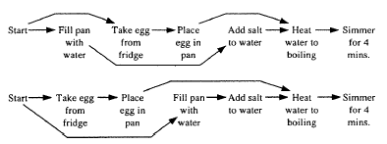
Topological Order – planning the project of boiling an egg (activity network)
Activity network:
Two different topological orders

Slide 5
Toplogical Order Algorithm
getTopologicalOrder()
vertexStack = new stack holding visited vertices
n = number of vertices in the graph
for (1..n)
nextVertex = unvisited whose neighbors are all visited
markVisited (nextVertex)
vertexStack.push(nextVertex)
return vertexStack
Carrano 852

Slide 6
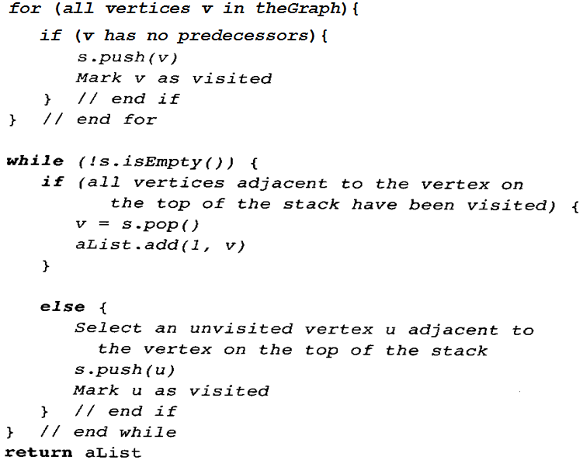

Slide 7
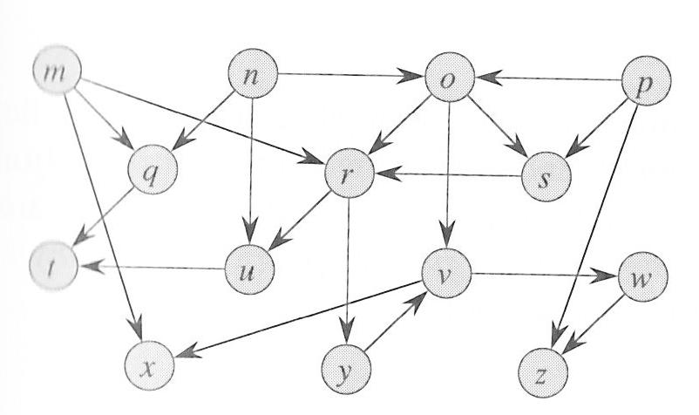
Exercise find toplogical order
getTopologicalOrder()
vertexStack = new stack holding visited vertices
n = number of vertices in the graph
for (1..n)
nextVertex = unvisited whose neighbors are all visited
markVisited (nextVertex)
vertexStack.push(nextVertex)
return vertexStack

Slide 8
Spanning Trees (on connected graphs)
Remember: a tree is an undirected, connected and acyclic graph
A spanning tree for a graph contains
Every vertex of the graph
Enough edges to be a tree
Usually a graph will have several spanning trees

Slide 9
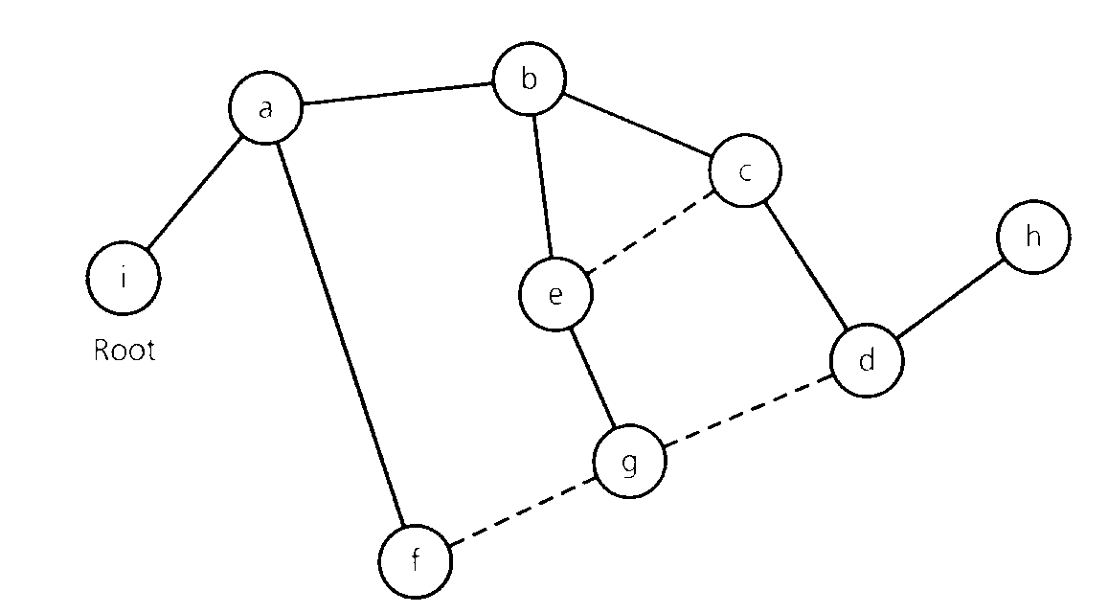
Example – Spanning Tree

Slide 10
Observations about undirected graphs that enable you to detect a cycle
A connected undirected graph
that has n vertices must have at least n-1 edges;
that has n vertices and exactly n-1 edges cannot contain a cycle
that has n vertices and more than n-1 edges must contain at least once cycle.

Slide 11
Finding a Spanning Tree
Remove edges from the graph (without disconnecting the graph) until it is acyclic – and a spanning tree emerges
Finding spanning trees can be done applying DFS or BFS
In both cases: mark the edges that is followed and the marked edges will constitute a spanning tree

Slide 12
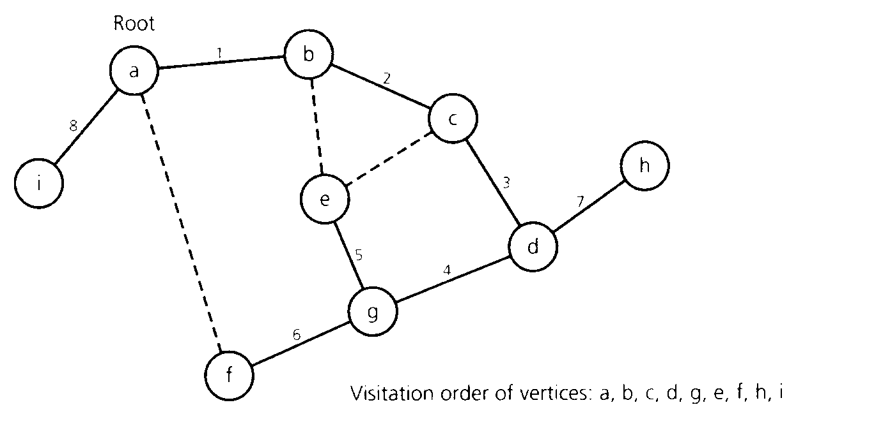
DFS Spanning Tree

Slide 13
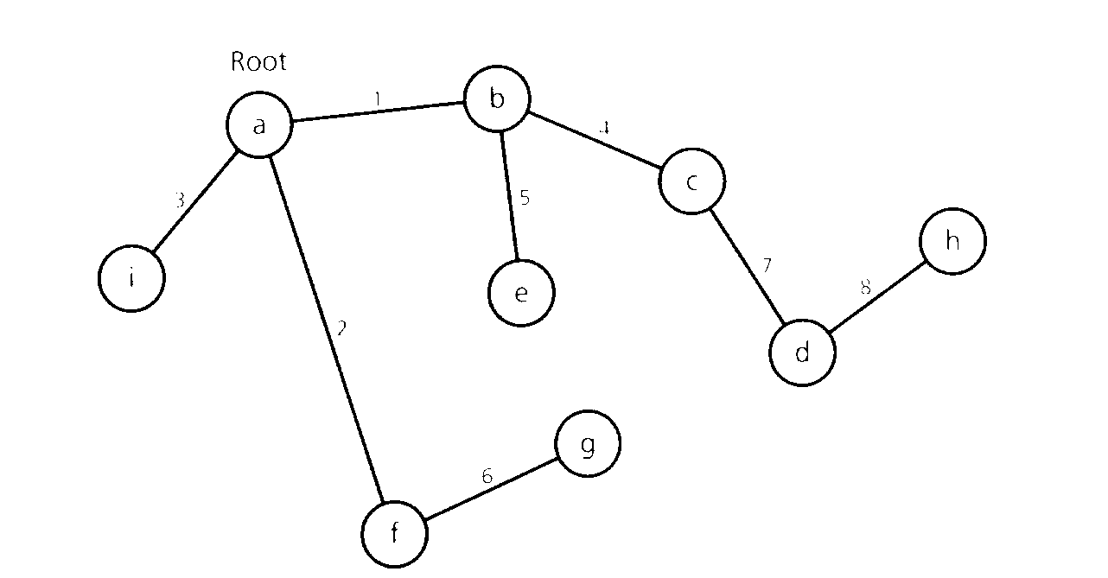
BFS Spanning Tree

Slide 14
Greedy Algorithms (Pattern for some graph algorithms – more in the next session)
General strategy for solving optimisation problems:
The solution is built step by step
In each step the most optimal partial solution is chosen.
Does not always work
But when it does, it is very nice.

Slide 15
Example
Controlling Pay-Back from a Vending Machine
For instance: the amount x is to be returned using the fewest possible coins:
48 cents using 25-, 10-, 5- and 1-cent coins
The greedy strategy works:
25, 10, 10, 1, 1, 1
11 cents using 7-, 5- and 1-cent coins
The greedy strategy does not work:
7, 1, 1, 1, 1
but 5, 5, 1 would be better.....
Why not?

Slide 16
Minimum Spanning Trees (”Lazy Railroad Constructor’s Problem”)
Problem:
Connect a number of towns with railroad lines, telephone or telegraph lines or …, so the total cost is minimised.
This is a graph problem: Towns are vertices and railroad lines are edges.
Solution: The cheapest connection is a minimum spanning tree.

Slide 17
Minimum Spanning Tree
Can be applying using several algorithms. We shall be studying two, both following the greedy pattern:
Prim's Algorithm
Kruskal's Algorithm
Both algorithms find minimum spanning trees in an undirected, weighted graph, but they are using quite different approaches

Slide 18
Prim’s Algorithm
Pick an (arbitrary) start vertex
While there are more unvisited vertices
Select the edge with minimum weight from a visited vertex (v) to an unvisited vertex (u)
Mark u as visited
Add u and the edge (v, u) to the minimum spanning tree.
Where is the “greediness”?

Slide 19
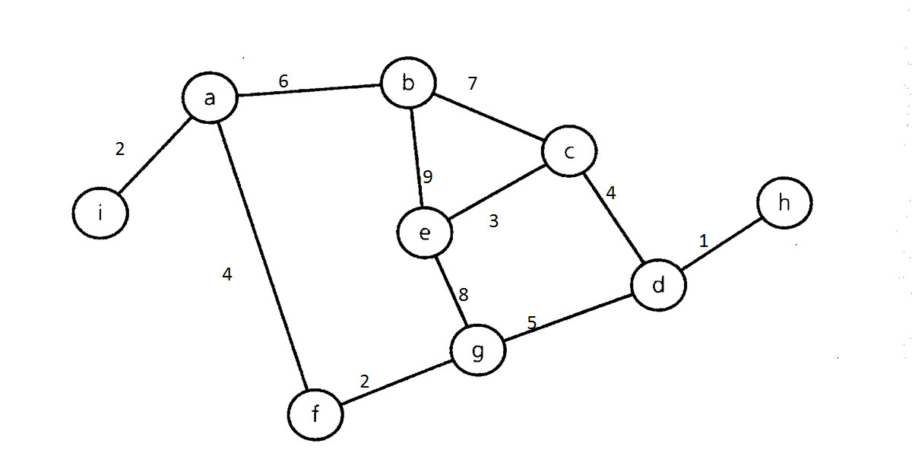
Prim’s Algorithm - Example

Slide 20
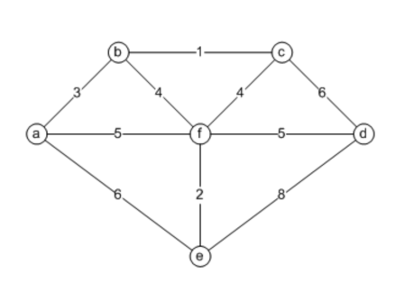
Exercise: Use Prim’s Algorithm to find a minimum spanning tree for this graph

Slide 21
Kruskal's algorithm
Quite different approach:
Step by step a number of sub trees are constructed and merged into larger trees:
In each step:
Select an edge with minimum weight
Check if the edge will create a cycle in set of sub trees, if not add the edge to set of sub trees
Eventually we have a minimum spanning tree

Slide 22
Kruskal's algorithm - Example

Slide 23
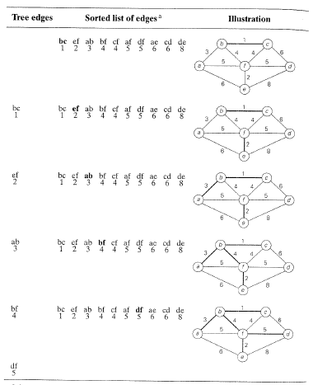
Example
Where is the “greediness”?

Slide 24
Kruskal’s Algorithm - Exercise

Slide 25
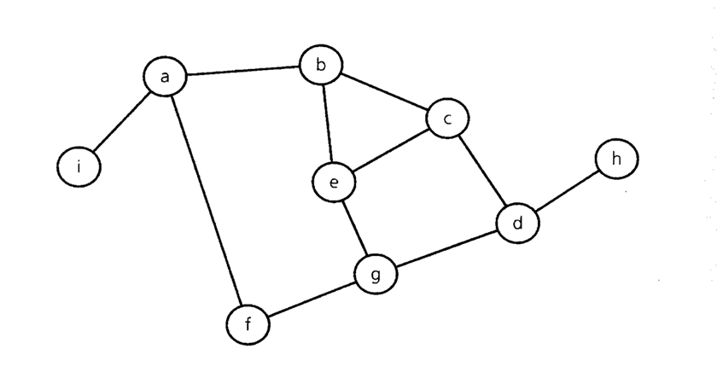
Shortest Path from one vertex (source) to every other in an Unweighted Graph
Path length == number of edges on the path
The set of vertices is split in two:
vertices where the shortest path is found
vertices where the shortest is still to be found

Slide 26
Shortest Path from one vertex (source) to every other in an Unweighted Graph
The algorithm proceeds as follows:
The shortest path to the source is known (0), so the source is added to the solution
All vertices not in the solution and adjacent to vertices in the solution are added (path length 1)
All vertices not in the solution and adjacent to vertices in the solution are added (path length 2)
And so on until all vertices are in the solution

Slide 27
Shortest Path from one vertex (source) to every other in an Unweighted Graph
shortestPathUnweighted (in v:Vertex)
q.createQueue()
q.enqueue(v)
d[v] = 0
while(!q.isEmpty()) {
w= q.dequeue()
for (each vertex u adjacent to w) {
if (d[u] == INF) {
d[u] = d[w] + 1;
p[u] = w
q.enqueue(u)
}
}// end for
} // end while
Data structure needed:
for each vertex v, distance d[v] from source vertex and predecessor p[v] in the path
queue for bfs

Slide 28
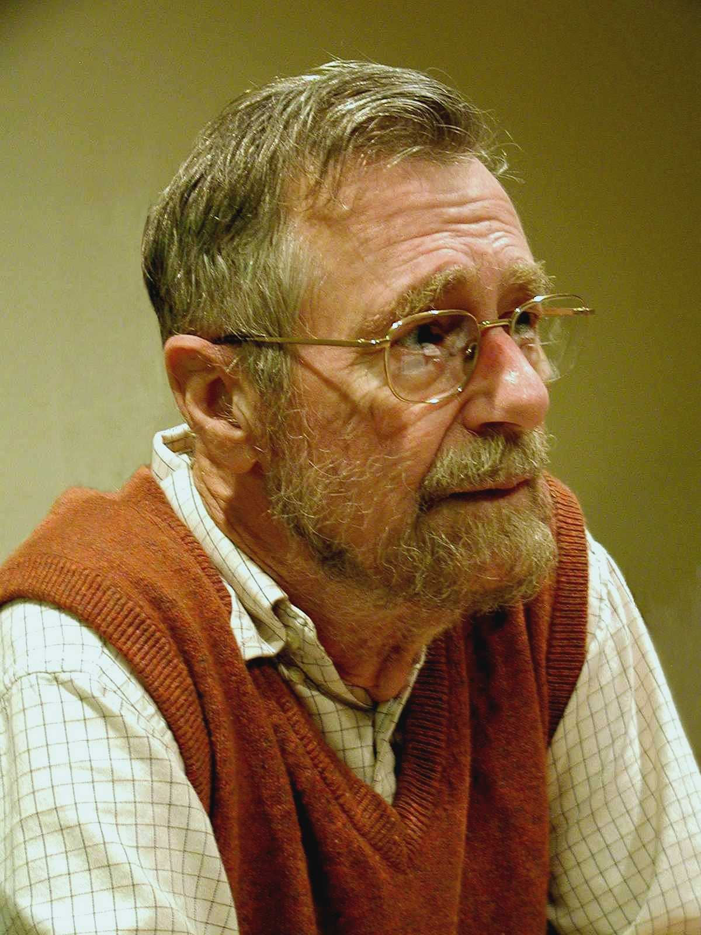
Dijkstra
A big name in CS:
http://www.cs.utexas.edu/users/EWD/
Shortest path
Semaphores
Multi programming
single core multitasking
“separation of concerns”
Verification
And much more…
… Go To Statement Considered Harmful
https://homepages.cwi.nl/~storm/teaching/reader/Dijkstra68.pdf
Edsger W. Dijkstra
EWD717.PDF

Slide 29
Shortest Path in an Weighted Graph Dijkstra’s Algorithm
Weighted, undirected graph; weights > 0
Problem:
finding the shortest (lowest weight) path from a given vertex to another
Dijkstra’s Algorithm finds the shortest path from a given vertex (source) to every other.
Dijkstra's Algorithm is often used:
routing in networks
navigation systems
www.krak.dk – www.maps.google.com
And much more

Slide 30
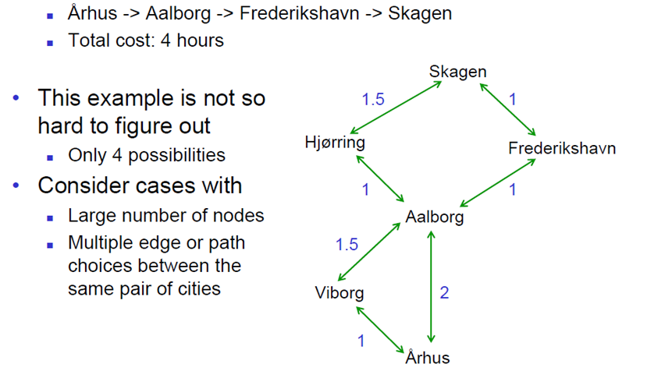
Shortest Path in an Weighted Graph Dijkstra’s Algorithm

Slide 31
The algorithm works as follows:
A set of selected vertices (S = Solution) is constructed:
At any point S contains the vertices to which the shortest path is known.
Initially S only contains the source
In each step a vertex is added to S
On termination S contains all vertices
An array (W) of weights of the shortest path through S known to each vertex is maintained:
Initially W is set to the first row of the adjacency matrix
W is adjusted as new vertices are added to S
At each step a vertex (u) with minimum weight in W and not in S is selected and added to S:
For every vertex not in S check, if it is cheaper to get to them through u. If this is the case, adjust W accordingly.

Slide 32
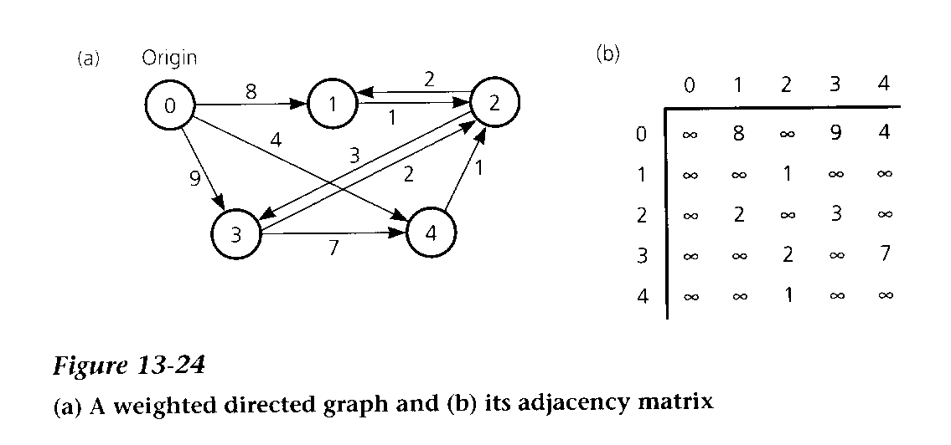
Where is the “greediness”?

Slide 33
Shortest Path in an Weighted Graph Dijkstra’s Algorithm
Note:
This version of Dijkstra’s Algorithm finds the lengths of the shortest paths, not the paths themselves
This could be achieved using a list of vertices for each vertex
These lists are to be adjusted when W is adjusted
Complexity:
O(|E| + |V|^2) = O(|V|^2) vertices in a linked list
O(|E| + |V| log|V|) for sparse graph and a heap as priority queue.

Slide 34
Dijstras on YouTube
https://www.youtube.com/watch?v=pVfj6mxhdMw (lists)
https://www.youtube.com/watch?v=WN3Rb9wVYDY (graphical)

Slide 35
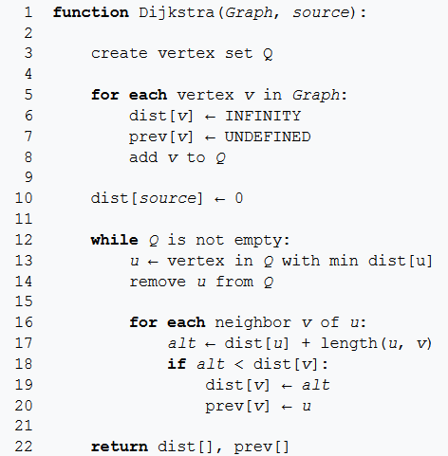
https://en.wikipedia.org/wiki/Dijkstra%27s_algorithm
The solution set S contains the vertices already removed.
Q is the set of vertices yet to be removed.
V is the set of all vertices.
V \ S = Q and
S U Q = V
Records the path

Slide 36
Dijkstra’s Algorithm - Exercise
Start in a

Slide 37
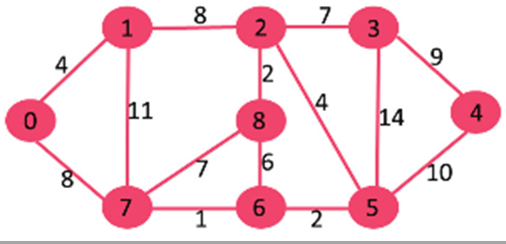
Dijkstra’s Algorithm - Exercise
Start in 0

Slide 38
ILO: (Intended Learning Outcome)
To be able to explain the following algorithms (what is it used for? and how does it work?):
Topological order
Minimum spanning trees (Prim and/or Kruskal)
Dijkstra’s shortest path algorithm.
Have a running implementation of a graph:
Can explain, use and modify this implementation
Have implemented a graph algorithm

